Slide 1
MNIST Demo
Seongbeen Lee
Sookmyung Women’s Univ.

Slide 2
Contents
MNIST classification

Slide 3
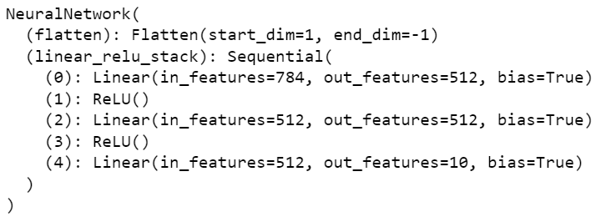
MNIST classification
MMIST dataset
http://yann.lecun.com/exdb/mnist/
Simplest model(MLP)

